Slide 1
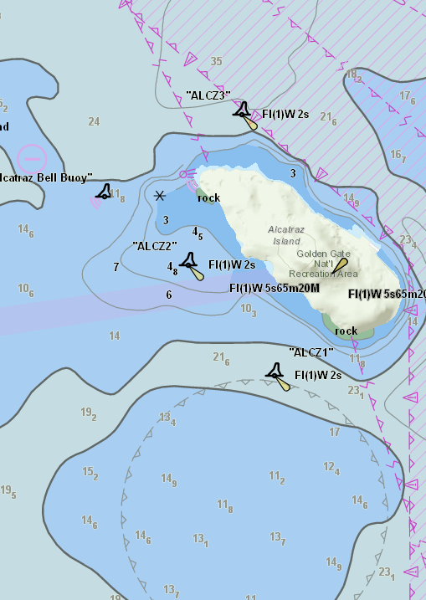

S-57 to S-101 Converter
S-101 PT01 5.1
Tom De Puyt

Slide 2
Introduction
Esri tasked to develop converter in 2010
Funded jointly by NOAA and Esri
Multiple iterations as S-100 and S-101 have matured
Version 0.8.9 was originally provided on June 30th 2015
Version 0.8.14 was provided at TSM3 September 2016
Version 0.8.19 was provided post TSM3
Baseline documents
S-101 ENC Product Specification 20150623_baseline
S-101 Data Classification and Encoding Guide Final Baseline (April 2014)
S-101 Feature Catalog baseline version 0.8.8
S-100 Edition 2.0.0

Slide 3
Implemented Requirements
Support S-100 Edition 2.0.0 changes to the Feature Catalogue schema
Version 0.8.8 of the S-101 Feature Catalogue (ROK)
Calculate ECDIS System Attributes
Default Clearance Depth (based on TSMAD28_DIPWG6_9.4A paper)
Surrounding Depth (based on TSMAD28_DIPWG6_9.4A paper)
Sector Extension (S-52 6.0 CSP LIGHTS06 logic)
In the Water (use DCEG definition of navigable water)
Flare Angle (S-52 6.0 CSP LIGHTS06 logic)
Notes:
Calculate Flare Angle
Logic found in CSP LIGHTS06
White, Yellow, Orange lights have a 45DEG value from top of display
All other lights default to 135DEG from top of display
If Orientation is set then use that value – double check CSP logic
Sector Extension
Logic found in CSP LIGHTS06
Default is 20mm
Mariner selection is 25mm
In the Water
Set attribute to True when it meets the DCEG definition of navigable water
Default Clearance Depth
Based on TSMAD28_DIPWG6_9.4A paper
Surrounding Depth
Based on TSMAD28_DIPWG6_9.4A paper

Slide 4
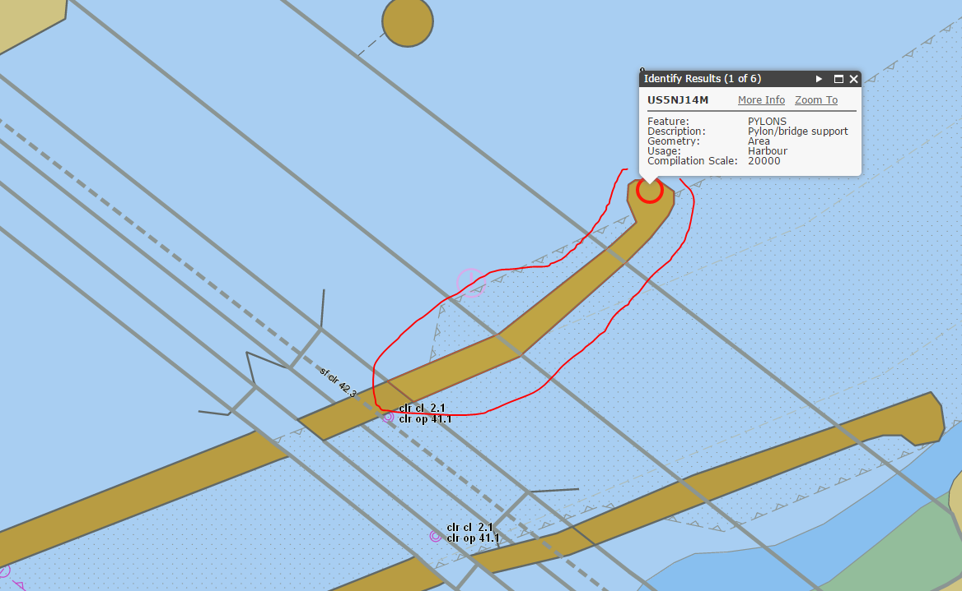
Implemented Requirements
Support new Bridge modelling
Implemented DCEG modeling
Limitation discovered when a multiple bridges share the same pylon
Each bridge touching that shared pylon gets converted as the same bridge aggregation
All features convert correctly
Potential solution
Create a C_AGGR
Notes:
Notes from April 30th email from Esri to NOAA
As we dive deeper into Bridges we have come across a limitation with the S-57 data. In order to properly map the S-57 bridge components and pylons to S-101 we need to know which features make up that bridge. It is easy enough to find all adjacent bridge segments and pylons (overlap or adjacent) but in a few cases the pylons are crossing multiple bridges. When this happens there is no way for us to know that the other bridge sharing the pylon isn’t part of the ‘single’ bridge we are trying to convert.
In the attached example there are 4 distinct bridges all sharing two pylons. The resulting conversion will create each span opening and span fixed feature correctly but there will only be a single bridge feature created instead of four and the single bridge feature will be aggregated to all the parts of all the bridges.
The only data solution we could think of for this scenario is for data producers to modify their S-57 data by creating a C_AGGR feature for the individual bridge and components. We could then use this C_AGGR relationship to correctly create bridge features and bridge aggregations. Any converter logic to try and solve this doesn’t seem to provide a 100% solution. We haven’t given up but I do want to start the conversation for an alternative data solution. I believe this is minor for test data since we will still have all the features converted in all scenarios. It just so happens in this scenario you will have one uber bridge.

Slide 5
Implemented Requirements
M_CSCL Conversion to Data Coverage features
No limit imposed.
CSCALE is used to populate maximum display scale
Datasets CSCL used to populate minimum display scale
Support V-AIS modeling
Notes:
Implement V-AIS Modeling
NEWOBJ for Virtual AIS features are now VirtualAISAidToNavigation features
S-57 Attribute CLSNAM will not map to S-100 attribute virtualAISAidToNavigationType (See DCEG for values)

Slide 6

Implemented Requirements
Implement min/max display scale override support for Data Coverage features
Added MinMaxDisplayScaleOverride.xml
Allows you to override existing:
M_CSCL feature’s CSCALE values
Sets minimum and maximum display scale values for M_COVR with CATCOV = 1 features when converted to Data Coverage features
According to S-101 “When a dataset has multiple Data Coverage features, then the minimum Display Scale must be the same for all Data Coverage features within the dataset. The maximum Display Scale for multiple Data Coverage features within a dataset may be the same or different.”
Notes:
Compilation Scale Override and Dataset Coverage conversion
Relates to minimumDisplayScale and maximumDisplayScale attributes and Dataset Coverage features
There will be no limit imposed. All M_CSCL features will be converted even if there are more than 3.
Values for min and max are in the feature catalog for each attribute
According to S-101 “When a dataset has multiple Data Coverage features, then the minimum Display Scale must be the same for all Data Coverage features within the dataset. The maximum Display Scale for multiple Data Coverage features within a dataset may be the same or different.”

Slide 7
Implemented Requirements
Support CATZOC modelling provided by DQWG
Based on DQWG Nov. 2014 report
Custom code to map CATZOC table was required
Esri modified feature catalog to include modeling found in DCEG and report
Version S-101_FC_0.8.9
Inconsistencies found
DCEG and Report did not match
Multiplicities not defined for all attributes
Defaulted to 0,1 when in doubt to avoid conversion errors
Attributes already defined in feature catalog 0.8.8 as simple, DQWG made them complex
verticalUncertainty is an example of this. Created a new complex attribute named verticalUncertaintyX
Notes:
QualityOfBathymetric_FeatureCatalogueChanges.xlsx is another document that helps explain the modeling we implemented.

Slide 8
Dropped Requirements
Adding DOCARE and LOKBSN to Group 1
Requires new geometries to be created in order to create holes in existing Group 1 features
Creating new geometries is outside the scope of the converter
Recommend further discussion

Slide 9
New Functionality
CATALOG.031 files are now supported
Updates and external file references are automatically applied
Updated log file
Added additional warning messages to identify gaps in the feature catalogue
Updated data dictionary for S-100 Dump utility
Implemented version control
As long as the schema does not change new content can be added
Allows updated feature catalogue files to be distributed without modifying the converter
Notes:
Implemented version control for Feature Catalog
As long as the schema does not change new content can be added
The last value of the version number can be incremented
For example S-101_FC_0.8.9.xml is the modified version containing M_QUAL
If the first or second version number is incremented the converter will not accept it.
For example S-101_FC_0.9.0.xml will be rejected
This allows new Feature Catalogs to be distributed without having to modify the converter.

Slide 10
Testing
The following datasets passed conversion
All NOAA dataset published on June 25, 2015
Mickelfirth 2007
Contribution from
IIC Technologies: creation of S-101 test data
IC-ENC: tested their complete set of ENC datasets and reported no errors
Caris: identifying issue with C2IL coordinates and curve records
ROK: providing a copy of their S-100 Viewer for testing
SevenCs: ObservationsOnS101ISOEncoding.doc
SPAWAR: DDR feedback
Notes:
creating Curve records without coordinates in the segment field (SEGH with no C2IL) for two point curves but in this situation the coordinates must be carried in the C2IL field”

Slide 11
Items to be Recognized
It was agreed during TSMAD 29 that S-57 Object and Attribute acronym values will be added to the Feature Catalogue Alias field for use by the converter.
As new bindings are added to the Feature Catalogue, using the existing S-100 Edition 2.0.0 schema, the S-57 to S-101 Converter will automatically discover them.
Warning messages have been added to the log file to help identify gaps in the S-101 Feature Catalogue
Notes:
Complex attributes that reference simple attributes with S-57 acronym values in the feature catalog’s alias field will automatically be discovered. If not special code will be required.

Slide 12
Recommendations
Encourage ENC producers and distributors to convert their ENC datasets using the latest version of the S-57 to S-101 Converter and provide their log file to the S-100WG. This will help identify any issues with the converter and help identify gaps with the S-101 Feature Catalogue.
Create an updated S-101 Feature Catalogue that is up to date with the DCEG baseline document at a minimum. This will allow the converter to convert 100% of the S-57 ENC content to S-101 and provide richer test data for the S-100/S-101 Test Bed project.
Have the DQWG and the DCEG work item leader discuss and harmonize the inconsistencies for Quality of Bathymetric Data.
Propose encoding guidance to create a C_AGGR feature in S-57 ENC for bridge features that share the same pylon.
Discuss alternatives for converting DOCARE and LOKBSN features to Group 1.

Slide 13
Addendum A
Documents the changes between version 0.8.14 and 0.8.19
Documents changes planned for a post 0.8.19 version after this meeting

Slide 14
S-101 Project Team is invited to
Endorse version 0.8.19+ of the S-57 to S-101 Converter for the current baseline
Note the improvements to the converter
Convert your S-57 ENC datasets and provide feedback to the project team
Discuss proposed recommendations

